Slide 1

Digital Poster Creation:
Basic Design Concepts and Tools
Alison Blaine, Jennifer Garrett, Hannah Rainey
go.ncsu.edu/digitalposter

Slide 2
Workshop Overview
Poster Elements:
Written content
Charts
Graphics
Design Principles
Tips and Tools
Create!
go.ncsu.edu/digitalposter

Slide 3
Before you begin . . .

Slide 4
Ask:
What are the most interesting or valuable findings from your research?
What is visually interesting about your research?
How will your presentation of the poster add interest?

Slide 5
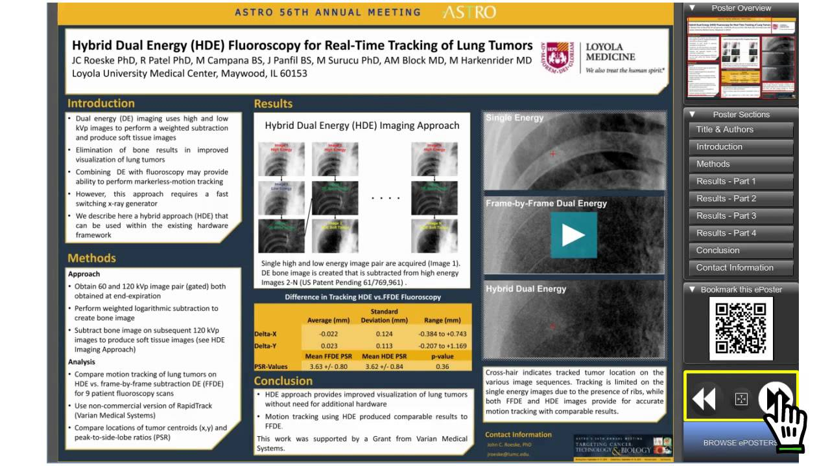
Poster Elements
Visual content:
Charts
Graphics
*Multimedia
Written content:
Text
*optional
Notes:
As this is a poster, the visual content is very important for grabbing the attention of your audience. With digital posters, you also have the ability to embed video or other animations.

Slide 6
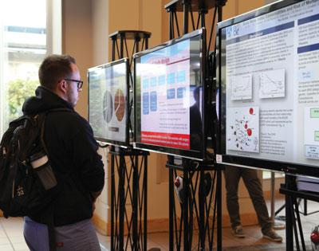
Consider the Digital Design Space
Dynamic or static
Readability is slower
Contrast important
Screen size
Short lines and paragraphs
Avoid clutter
Source: BWH Bulletin, June 7, 2013
Notes:
Dynamic -- slideshows, videos, animations possible.
People read slower on screen than they do in print. ~25% slower

Slide 7
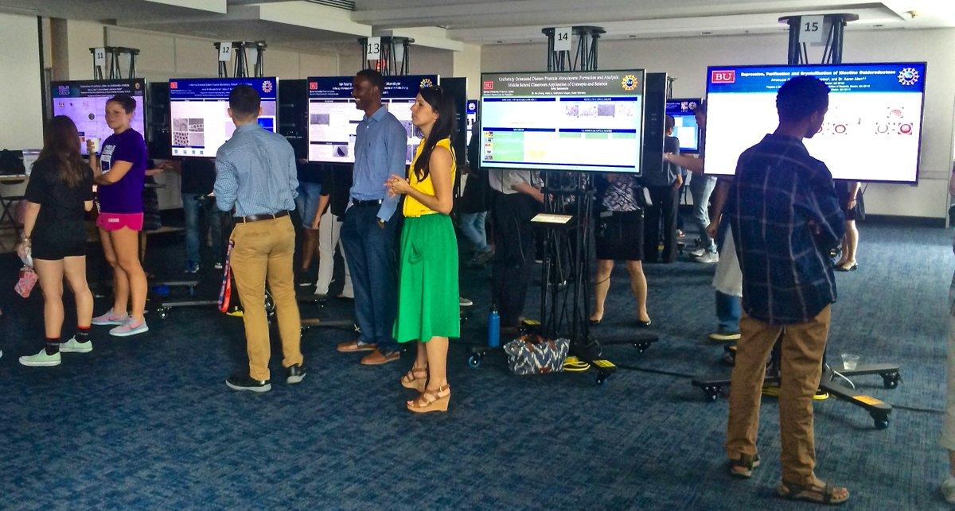
Example digital poster session
Source: Twitter
Notes:
Consider the readability issues of having small text and a white background.

Slide 8

Charts
Fonts should be readable from a distance
Concise captions
Annotation
Labeled data points
Consider light background color alternatives to white

Slide 9


Graphics
Good ratio of graphics to text
Avoid clip art. Use high definition graphics and images.
Google has advanced search tools to help with finding HD images

Slide 10
Written Content
Short & concise (300-400 words)
Limit the use of different font types (2)
Recommended fonts:
Times New Roman
Calibri or Arial
Notes:
Source: http://www.eposterboards.com/guidelines/

Slide 11
Text
Readable from 3 feet away
Title (85 pt)
Headers (44 pt)
Body (28 pt or higher)
Notes:
These are guidelines. Do not go smaller than 28 pt.

Slide 12
Text
Title: At the top with author information (name, position, affiliation)
Common Headings (usually the same as a printed poster):
Abstract Background Introduction Methods Results Conclusions Acknowledgements/References

Slide 13
Design Principles
Color
Type
S P A C E
Notes:
J

Slide 14
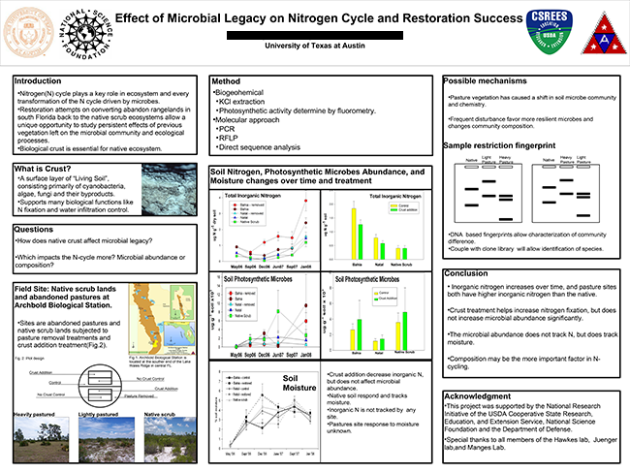

Slide 15
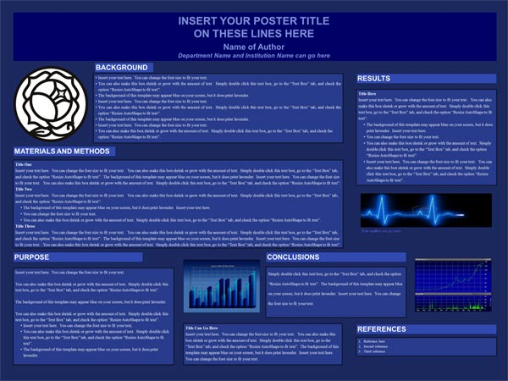

Slide 16
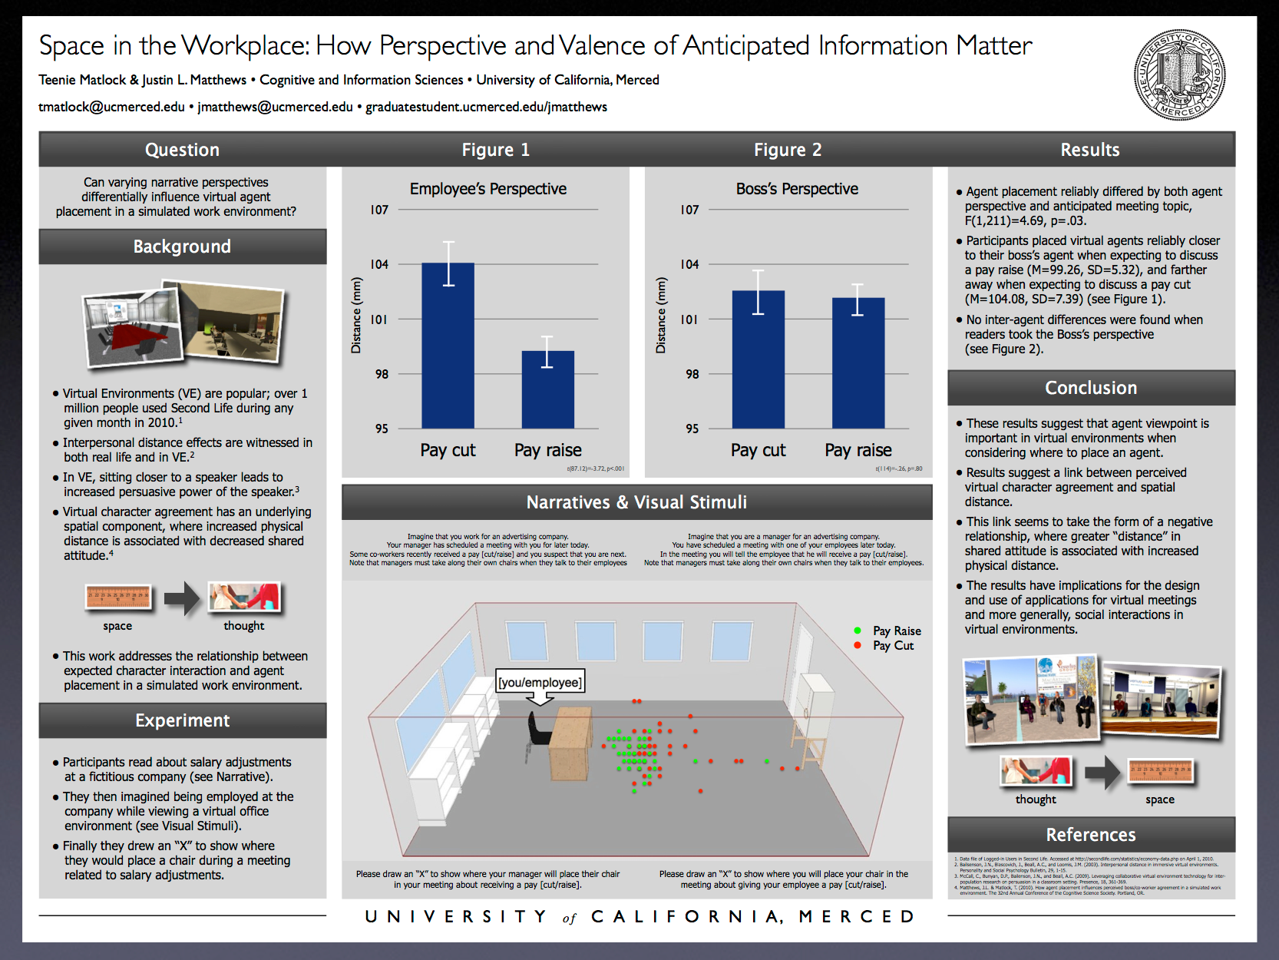

Slide 17
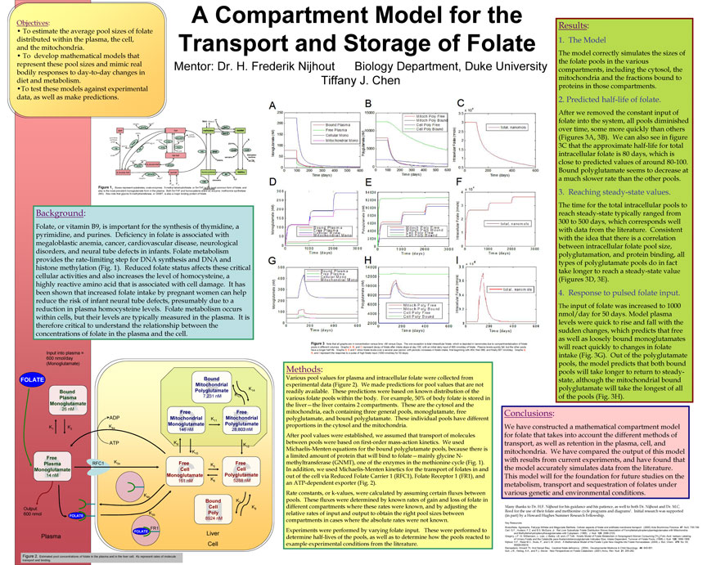

Slide 18


Slide 19
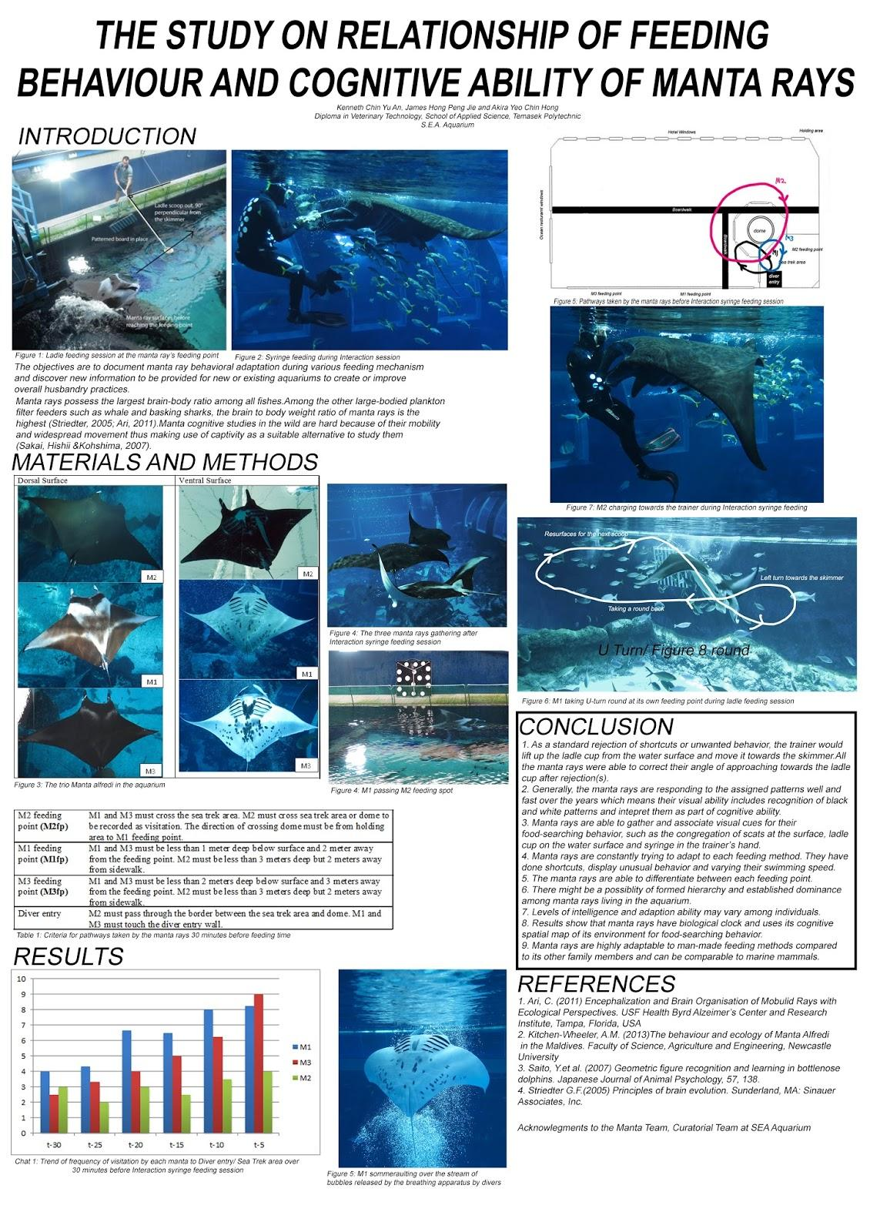

Slide 20
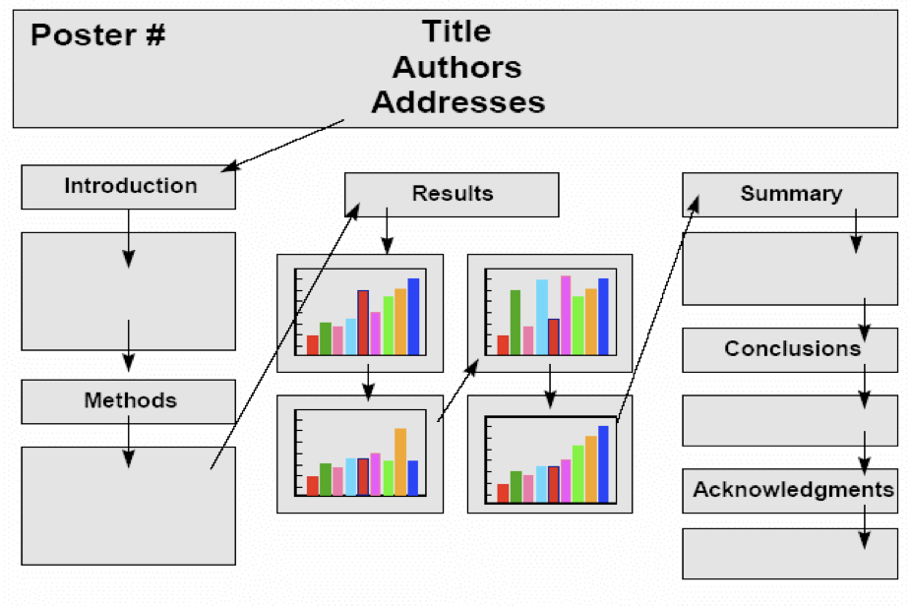
Plan your layout
Notes:
Information should flow in a natural way: top to bottom and left to right

Slide 21
Size and aspect ratio
Know the final medium
Will it be printed on 20x30 poster board?
For digital, is it a standard or widescreen?
Digital displays:
For widescreen HD display:
Aspect ratio 16:9
1920 x 1080 pixels
Inches - 40.97 x 23.04
DPI - dots per inch

Slide 22
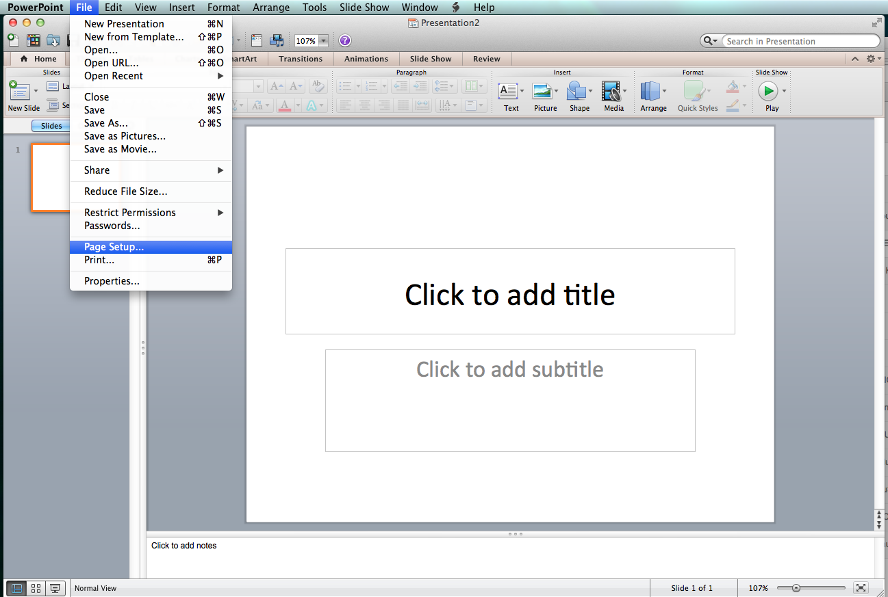
Using PowerPoint on a Mac
Download and open PowerPoint template from the workshop folder
Sizing your poster:
File > Page Setup > Change Width and Height
Background
Format > Slide Background
go.ncsu.edu/digitalposter
Notes:
Now using a laptop we are going to open up the PowerPoint template from the workshop folder. Your first step should be to size your poster. Most of your research poster guidelines should specify what dimensions you need. If is important to stick to these dimensions because you are sometimes fitting your poster to the space that will be available for your presentation. If you go to File>Page Setup>Slide Sized for Onscreen-show (16:9) or set the width to 41 and the height to 23 inches. Now let’s move on to the background. You can change this at any time by going to Format>Slide background remember to pick a color that is aesthetically pleasing.

Slide 23
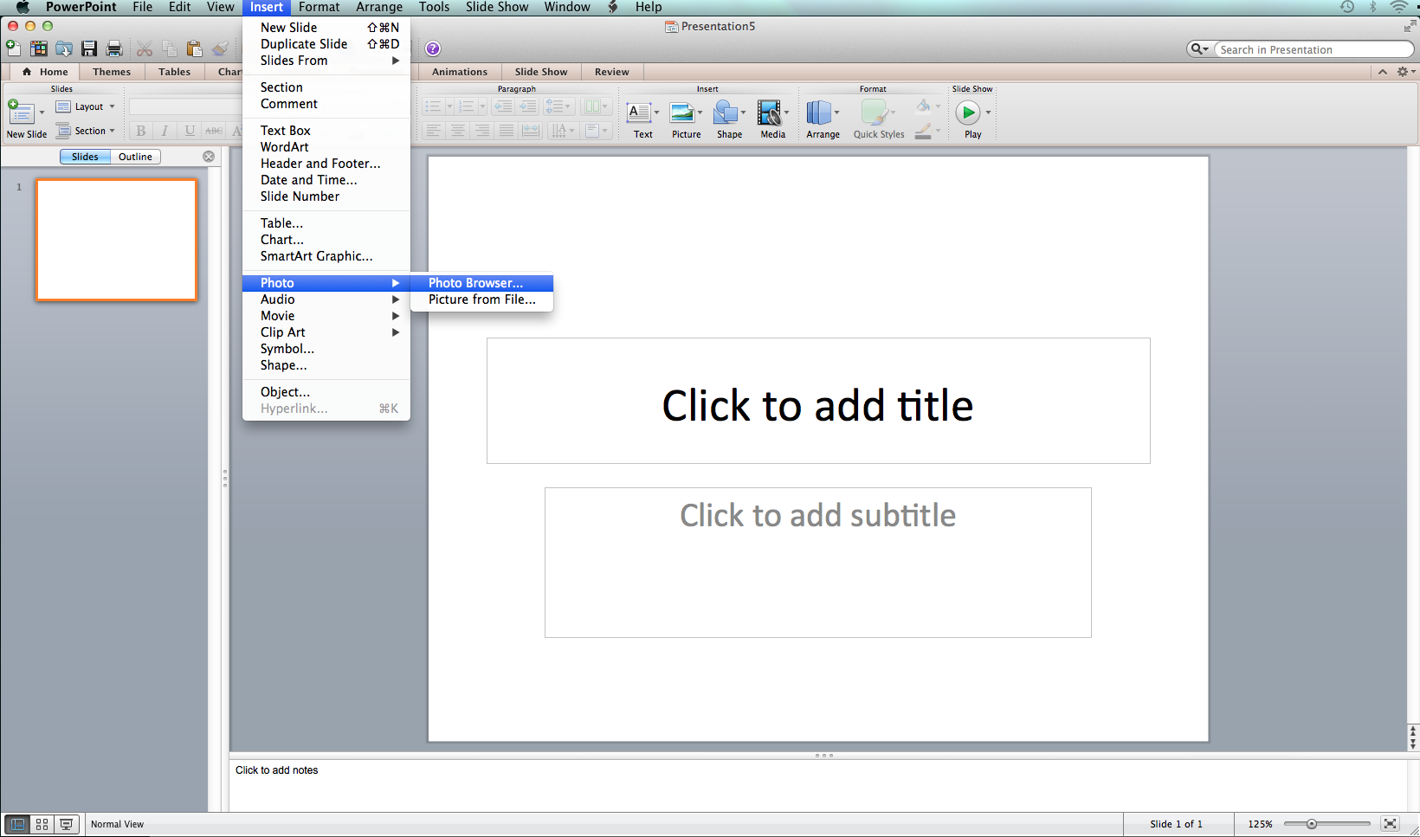
Using PowerPoint on a Mac
Guides/Rulers
View>Guides>Static Guides
Columns
Insert>Textbox
Images
Insert>Photo>Photo Browser...
Charts
Insert>Chart
Notes:
Make sure you have a general idea of an outline for your poster before you start adding these elements.

Slide 24
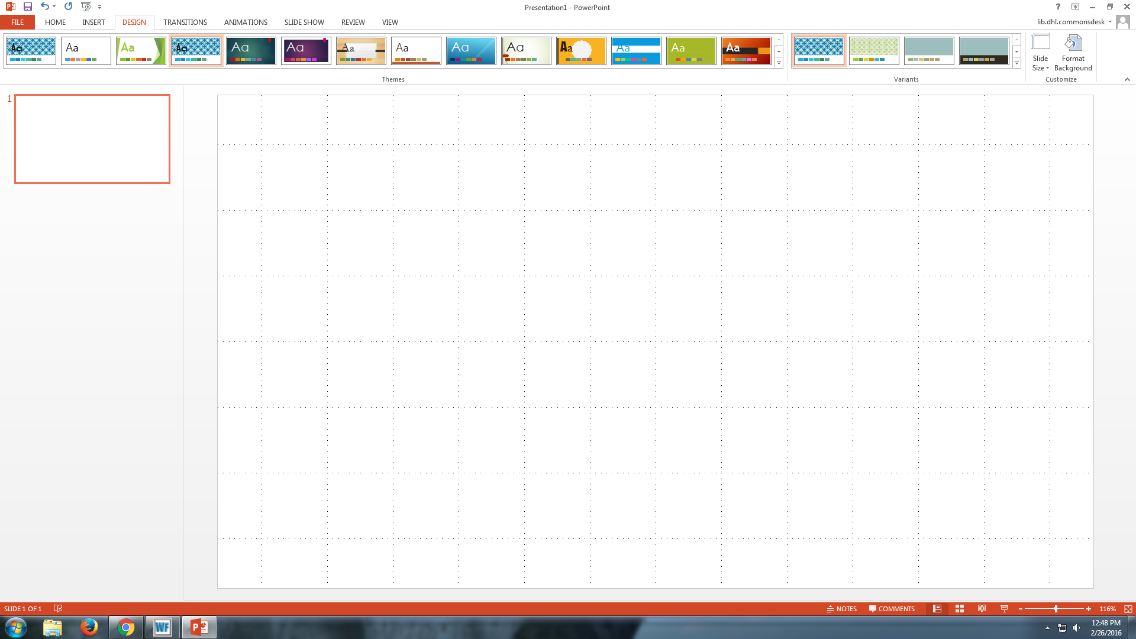
Using PowerPoint on Windows
Open PowerPoint and use a blank, white template
Sizing your poster:
Design > Slide Size
Background
Design > Format Background
Notes:
Now using a laptop we are going to open up PowerPoint and select a blank, white template. Your first step should be to size your poster. Most of your research poster guidelines should specify what dimensions you need. If is important to stick to these dimensions because you are sometimes fitting your poster to the space that will be available for your presentation. If you go to File>Page Setup>Slide Sized for Onscreen-show (16:9) or set the width to 41 and the height to 23 inches. Now let’s move on to the background. You can change this at any time by going to Format>Slide background remember to pick a color that is aesthetically pleasing.

Slide 25
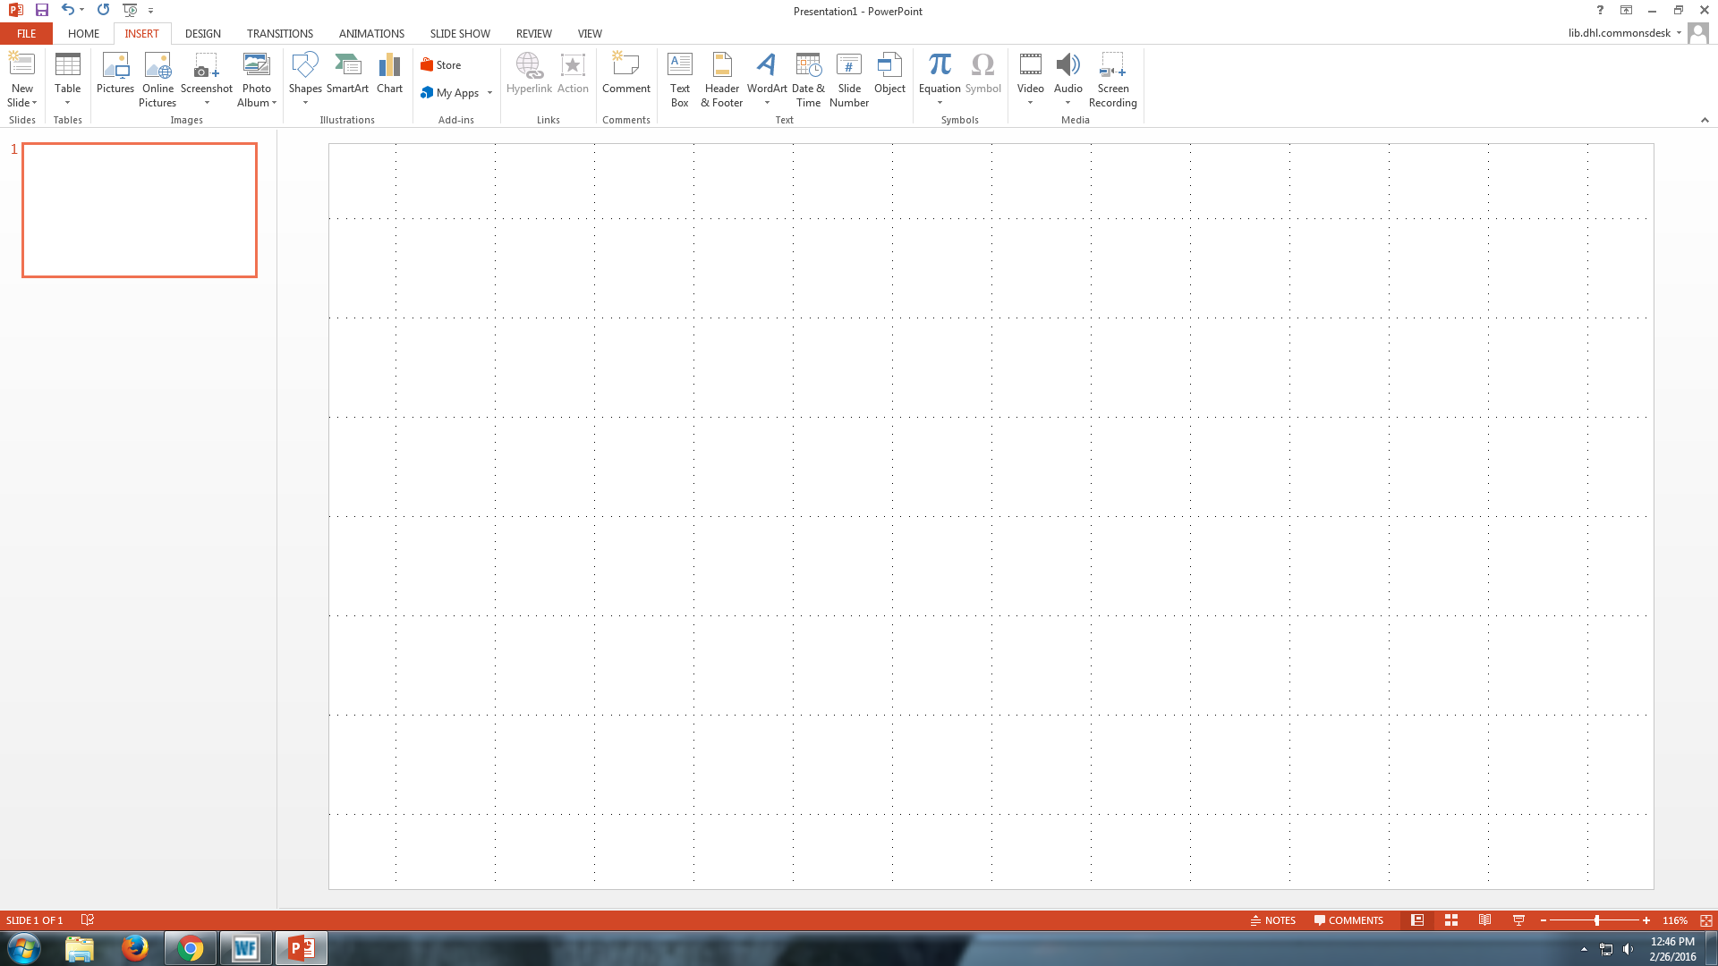
Using PowerPoint on Windows
Gridlines
View > Gridlines
Columns
Insert>Textbox
Images
Insert>Pictures
Charts
Insert>Chart
Notes:
Make sure you have a general idea of an outline for your poster before you start adding these elements.

